Slide 1
Applicaciones de NPL
Hi!
Aluu!
Salut!
Jambo!
Oi!
Daniel Arias Garzón

Slide 2
Contenidos
01
02
03
04
Categorización de Texto
Traducción
POS Tagging
Analisis de Sentimientos
05
06
07
Predicción de Texto
Named Entity Recognition (NER)
Transformers y reformers

Slide 3
01
Analisis de sentimientos
¡Hola!

Slide 4
Analisis de sentimientos
El análisis de sentimiento es el proceso de analizar texto digital para determinar si el tono emocional del mensaje es positivo, negativo o neutro.
Negativo
Neutral
Positivo

Slide 5
02
Categorización
Jambo!

Slide 6
Tipos de categorización
0
1
No supervisado
Supervisada
Clases no fijas
Zero, One o Few shot
Clases Fijas
Algoritmos de clasificacion binaria o de mas clases

Slide 7
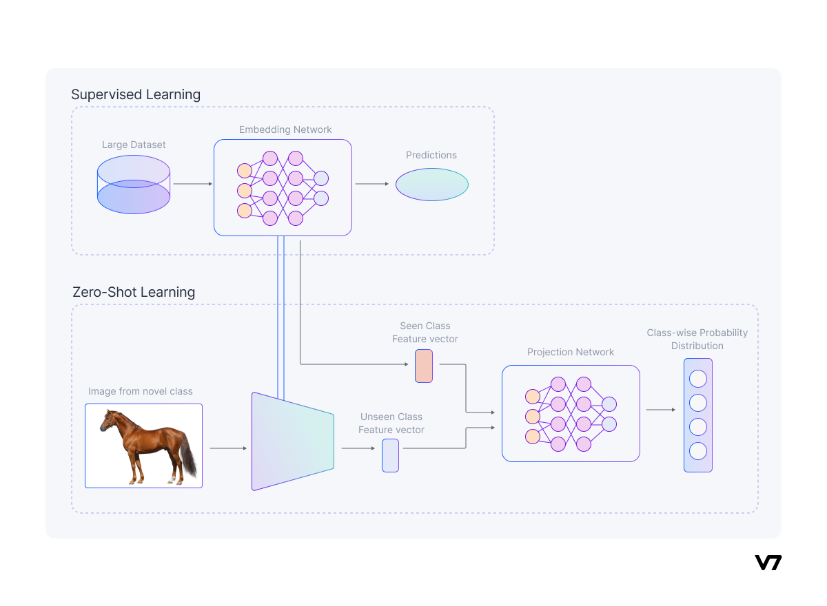
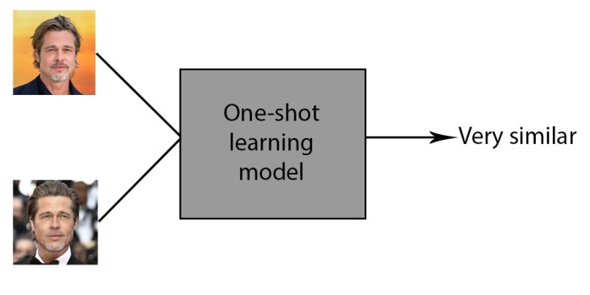
Zero y One shot

Slide 8
Traduccion
Ni hao!
03

Slide 9
POS Tagging
Hi!
04

Slide 10
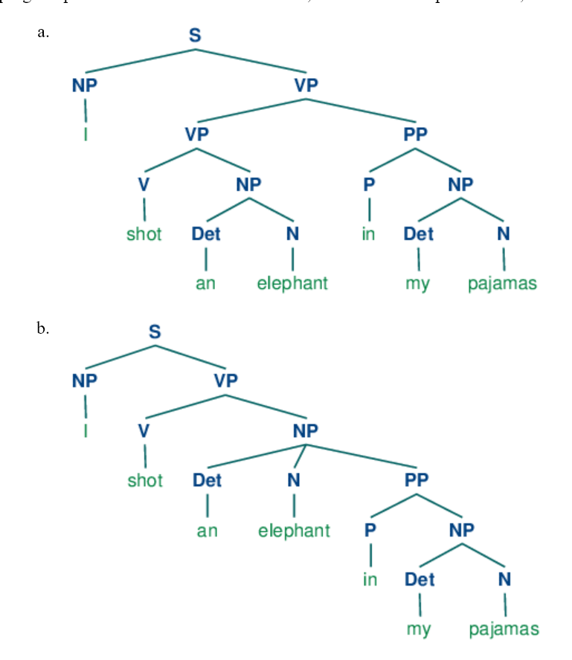
POS tagging: Explicación con un árbol

Slide 11
Prediccion de Texto
Oi!
05

Slide 12
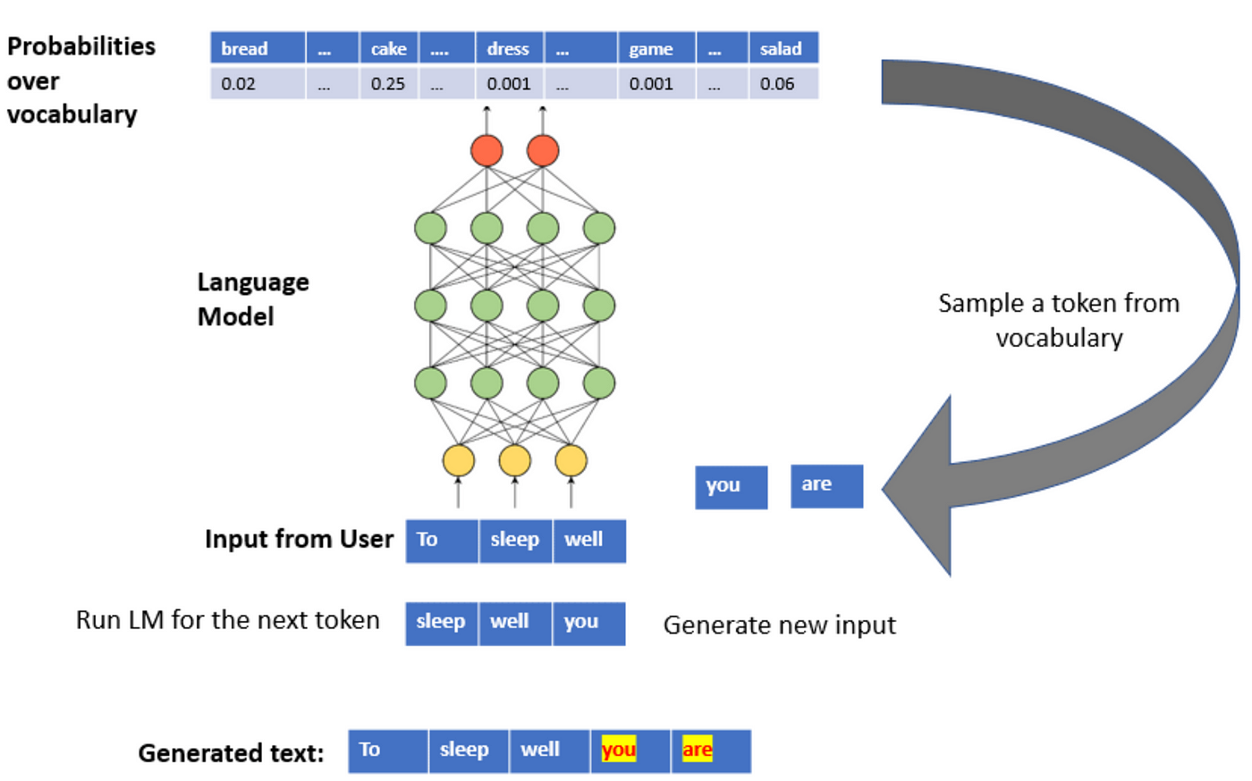
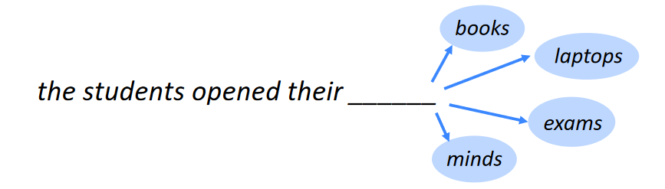

Slide 13
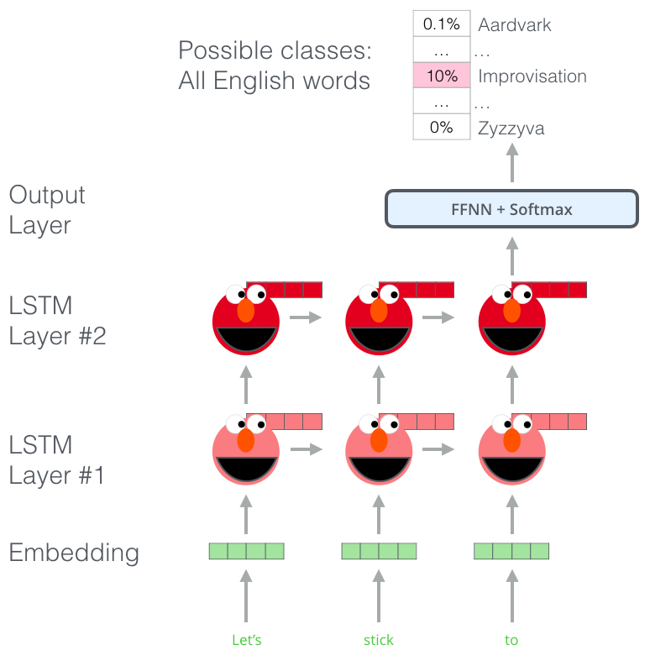
Embeddings from Language Models

Slide 14
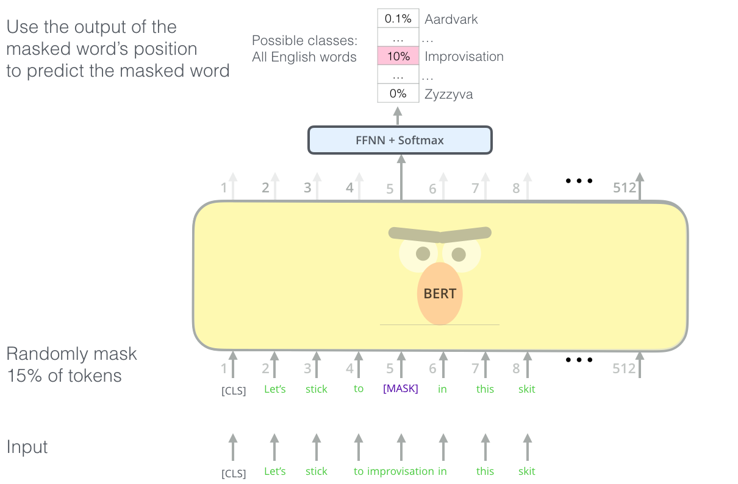
Bidirectional Encoder Representations from Transformers

Slide 15
Named Entity Recognition (NER)
¡Hola!
06

Slide 16


Slide 17
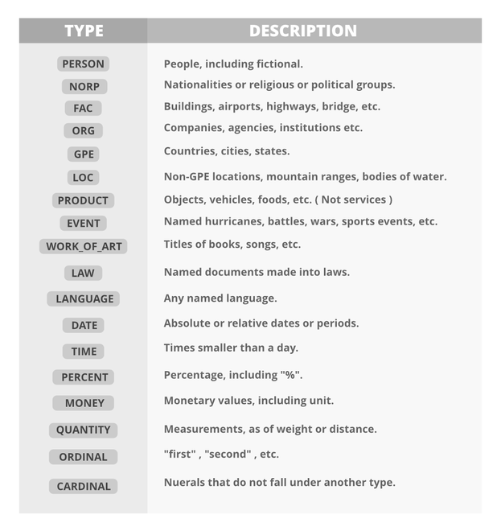

Slide 18
Transformers
Ni hao!
07
Kia Ora!

Slide 19
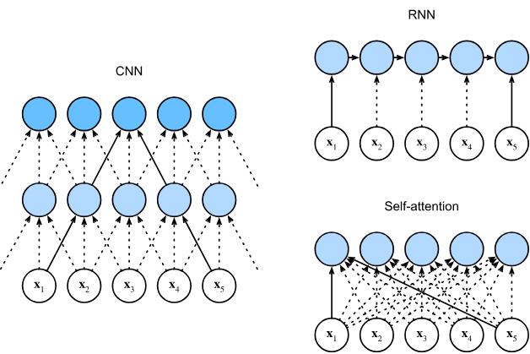
Mecanismos de attencion

Slide 20
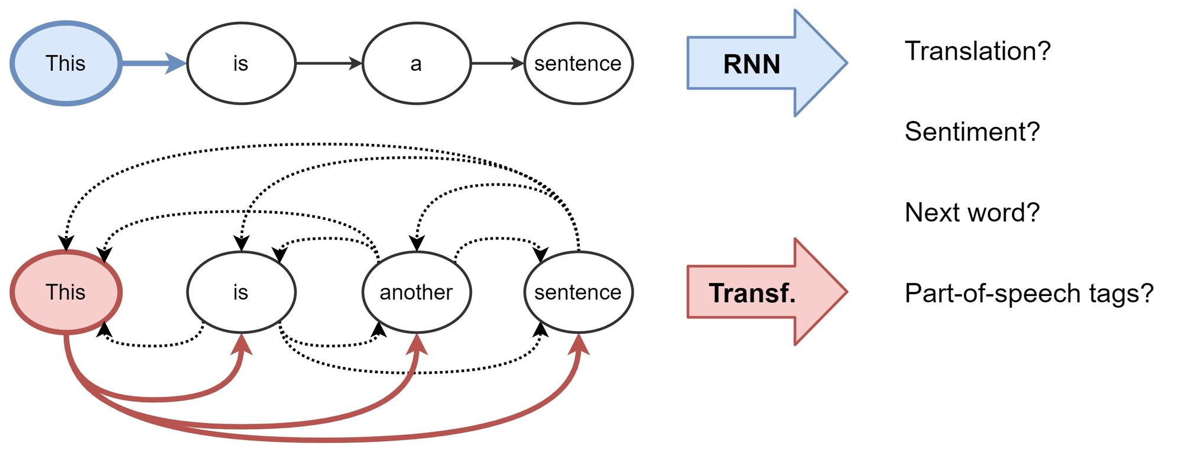
Mecanismos de attencion

Slide 21
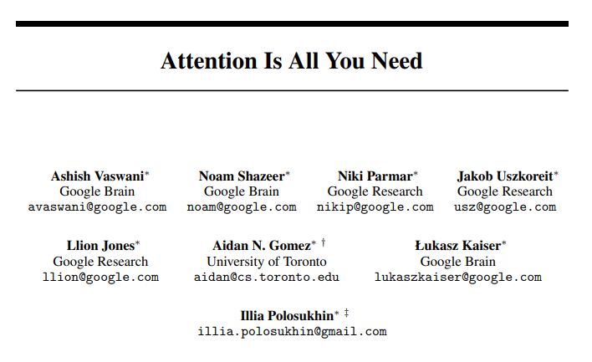
https://arxiv.org/pdf/1706.03762.pdf

Slide 22
Mecanismo de atencion
began
colonize
certain
As aliens entered our planet
and
to
a
group…
earth

Slide 23
Mecanismo de atencion
LSTM and GRU Reference window
Attention Reference window
RNN reference window
As aliens entered our planet and began to colonize earth a certain group

Slide 24
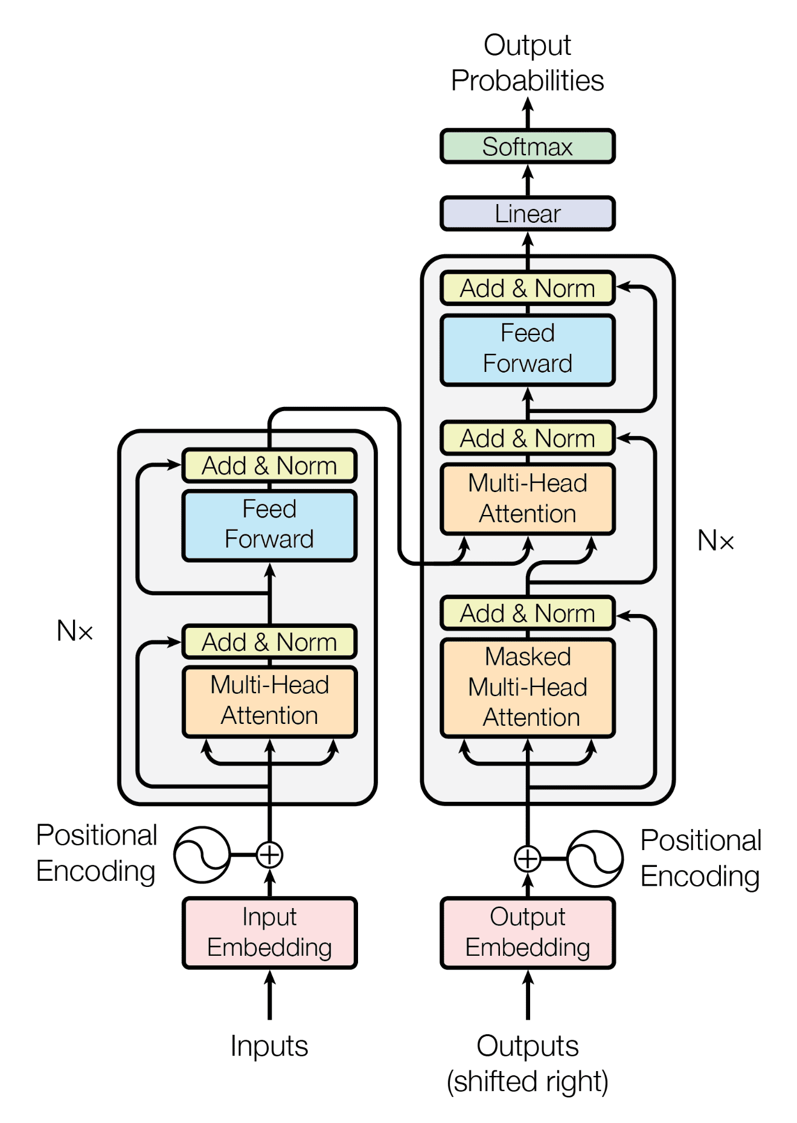
Transformer

Slide 25
Input Embeddings
“Hi how are you”
Transformer
“I am fine”
Hi how are you

Slide 26
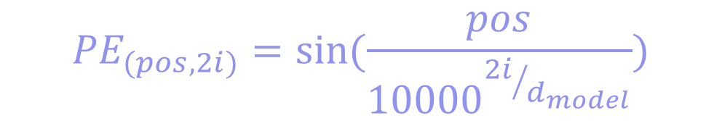
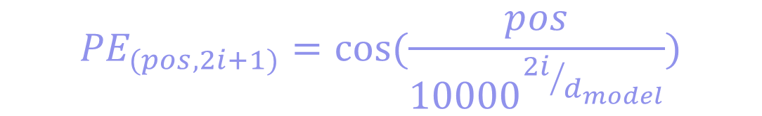
Positional Encoding
$${PE}_{(pos,2i)}=sin⁡(\frac{pos}{{10000}^{{2i}/{d_{model}}}})$$
$${PE}_{(pos,2i+1)}=cos(\frac{pos}{{10000}^{{2i}/{d_{model}}}})$$

Slide 27
Encoder Layer

Slide 28
Self attention
Linear
Query
Key
Value
Concat
MatMul
SoftMax
Scale
Linear
Linear
Linear
MatMul
Linear
Linear
Linear
Q
K
V

Slide 29

Self attention
Linear
Key
Scores
Query
Concat
MatMul
SoftMax
Hi how are you
Hi
98
27
10
12
Scale
how
27
89
31
67
MatMul
are
10
31
91
54
$$\sqrt{d_{k}}$$
you
12
67
54
92
Linear
Linear
Linear
Q
K
V

Slide 30
Self attention
Hi how are you
Hi
0.7
0.1
0.1
0.1
Linear
Softmax
how
0.1
0.6
0.2
0.1
Concat
are
0.1
0.3
0.6
0.1
you
0.1
0.3
0.3
0.3
MatMul
SoftMax
Attention Weights
Scale
Value
Output
MatMul
Linear
Linear
Linear
Q
K
V

Slide 31
Multihead Attention
Output
Output
Self attention head
Self attention head
Query
Key
Value
Query
Key
Value

Slide 32
Residual Conection, Layer Norm and Feed Forward
Output
Input
Output
LayerNorm
Lineal
ReLu
Lineal
Output
Input
Output
LayerNorm
Query
Key
Value

Slide 33
Decoder Layer

Slide 34
Masked Multihead attention
Linear
Concat
MatMul
SoftMax
<start> i am fine
<start>
0.7
0.1
0.1
0.1
Mask
i
0.1
0.6
0.2
0.1
Scale
am
0.1
0.3
0.6
0.1
MatMul
fine
0.1
0.3
0.3
0.3
Linear
Linear
Linear
Q
K
V

Slide 35
Masked Multihead attention
Scaled Scores
Look-Ahead Mask
Masked Scores
0.7
0.1
0.1
0.1
0
-inf
-inf
-inf
0.7
-inf
-inf
-inf
0.1
0.6
0.2
0.1
0
0
-inf
-inf
0.1
0.6
-inf
-inf
0.1
0.3
0.6
0.1
0
0
0
-inf
0.1
0.3
0.6
-inf
0.1
0.3
0.3
0.3
0
0
0
0
0.1
0.3
0.3
0.3

Slide 36
Masked Multihead attention
<start> i am fine
<start>
1
0
0
0
i
0.37
0.62
0
0
Softmax
am
0.26
0.31
0.43
0
fine
0.21
0.26
0.26
0.26

Slide 37
Decoder Layer
Codified Inputs
Codified Outputs
Query
Key
Values

Slide 38
Linear Classifier and Final Softmax
Probabilidad ∑ = 1
N Class (vocab size)
N Class (vocab size)

